Slide 1
Calibration and validation of the Ice Floe Tracker algorithm
Cloud mask
Preprocessing
Ice labeling (semantic segmentation)
Floe detection (object-based segmentation)
Tracking
Notes:
Should cross compare Ellen’s histogram method with the IFT method for #3
Idea from Ellen about GUI for manual pixel labeling – see if we can figure out what it’s called

Slide 2
Timeline
Watkins et al. “Observing floe-scale ice motion during summer” AoG
(Dec) Poster at AGU: Fram Strait dataset and demonstration of data utility
(Dec) Waiting for co-author feedback (received comments from Ellen, Jenny)
(May) Poster at AMS: FSD Seasonality, Fram Strait Dataset, IFT outline
Revised draft to coauthors + Jenny by Nov. 25, 2024
Init goal to re-submit to Annals of Glaciology by Dec. 6, 2024, on backburner now.
Nov
Dec
Finished 2024 NASA report
Jan
Continuing work on the validation dataset
Literature review for evaluation metrics paper
Developing methods for intercomparison
Watkins et al. Calibration/validation of the cloudmask, preprocessing, segmentation, and tracking (for original IFT) IEEE TGRS
Description of cal-val methods
Validation dataset, updated algorithm description
Feb
Mar
IFT.jl updates: removed Python dependency for latlon.py, implemented simpler rotation registration
Apr
AMS poster presentation
May
Jun
Watkins et al. “Evaluating object-based sea ice segmentation.” IEEE TGRS
Evaluation metrics intercomparison. Extension of Simon’s methods.
Side by side comparison of Lopez-Acosta, Buckley, and the new tiling method, just focusing on the segmentation quality
Jul
Aug
Sep
Watkins et al., “IceFloeTracker.jl: Open Source Software for …” JOSS
Demonstrate scientific need for software, document its capability
Want to have improved, clean API so that it can be as easy to modify as we want it to be

Slide 3
Timeline – Tasks and expected time requirements
Landmask function (nice to have)
The landmask we use is from OpenStreetsMap (OSM), which has accuracy issues at high latitudes
We could access the OpenStreets data directly, rather than downloading the images from NASA
Or, we could use a more accurate map, like this one data.mendeley.com/datasets/9r93m9s7cw/1
Cloudmask function (critical)
API update: create_cloudmask(fc_img, CloudMaskAlgorithm)
CloudMaskAlgorithm can inherit the ImageBinarization type, and the default should match exactly the original IFT cloud mask algorithm.
The output should be a binary image, with clouds = 1
The tiling algorithm can then use two calls to create_cloudmask, so that one is the “red mask” thing.
Preprocessing function(s) (critical)
API update: preprocess(image(s), ImageFilterAlgorithm) (ideas?)
Idea is that the preprocess functions map images to images, while segmentation maps images to labels
The preprocessing section of the code would then be a sequence of ImageFilterAlgorithms, some of which that depend on each other
TiledAdaptiveHistogram(tc_img, fc_img, tiles, adapthisteq_params)
Clean up the equalize/sharpen/reconstruct functions to have consistent input image type handling

Slide 4
Timeline – Tasks and expected time requirements
Segmentation functions(s) (critical)
API update: ImageSegmentationAlgorithm, SegmentedImage
get_ice_masks – Minki is working on this part of the algorithm. We should add this to the output.
Side note: anecdotally, the ice masks seem more sensitive to tile size than the preprocessing does
Disentangling the segmentation steps
Identifying which steps have minimal effects on the output
Post processing
Image morphology and regularization seem like post processing to me in a sense, could be part of segmenting
Tracking
Algorithm improvements
Addressing the bias with sorting largest to smallest
Input filtering with joint distribution

Slide 5
Timeline – Tasks and expected time requirements
Validation dataset
Remaining floe labels, cleaning up the landfast ice masks that aren’t well aligned
Ice/water discrimination masks – some images are clear enough that we can do a full ice/water mask in I think a straightforward way, using histogram thresholding with NDSI tie points and manual correction
Selecting images with large clear-sky fractions and large numbers of ice floes to do expanded images

Slide 6
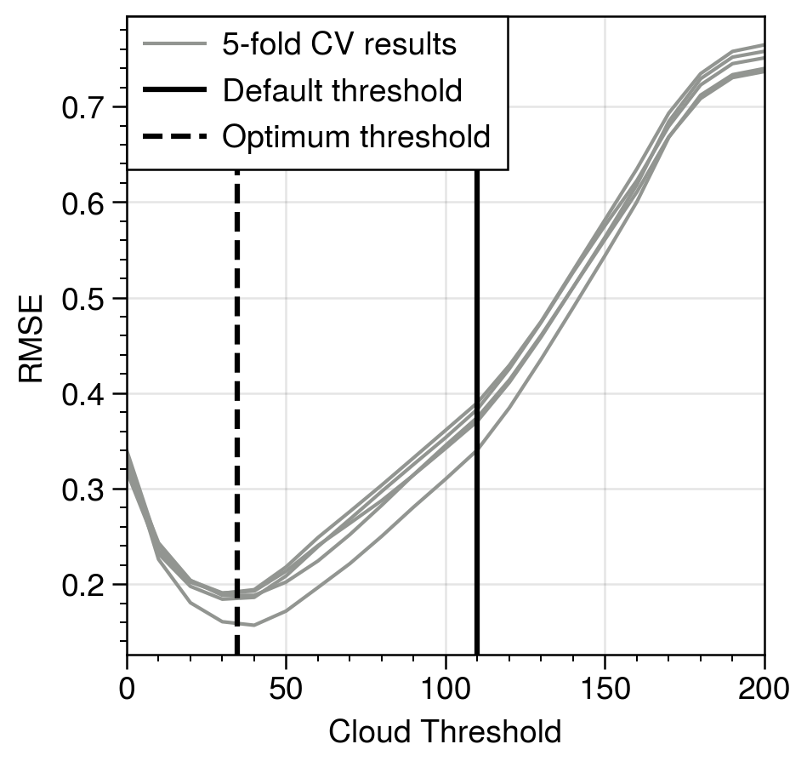
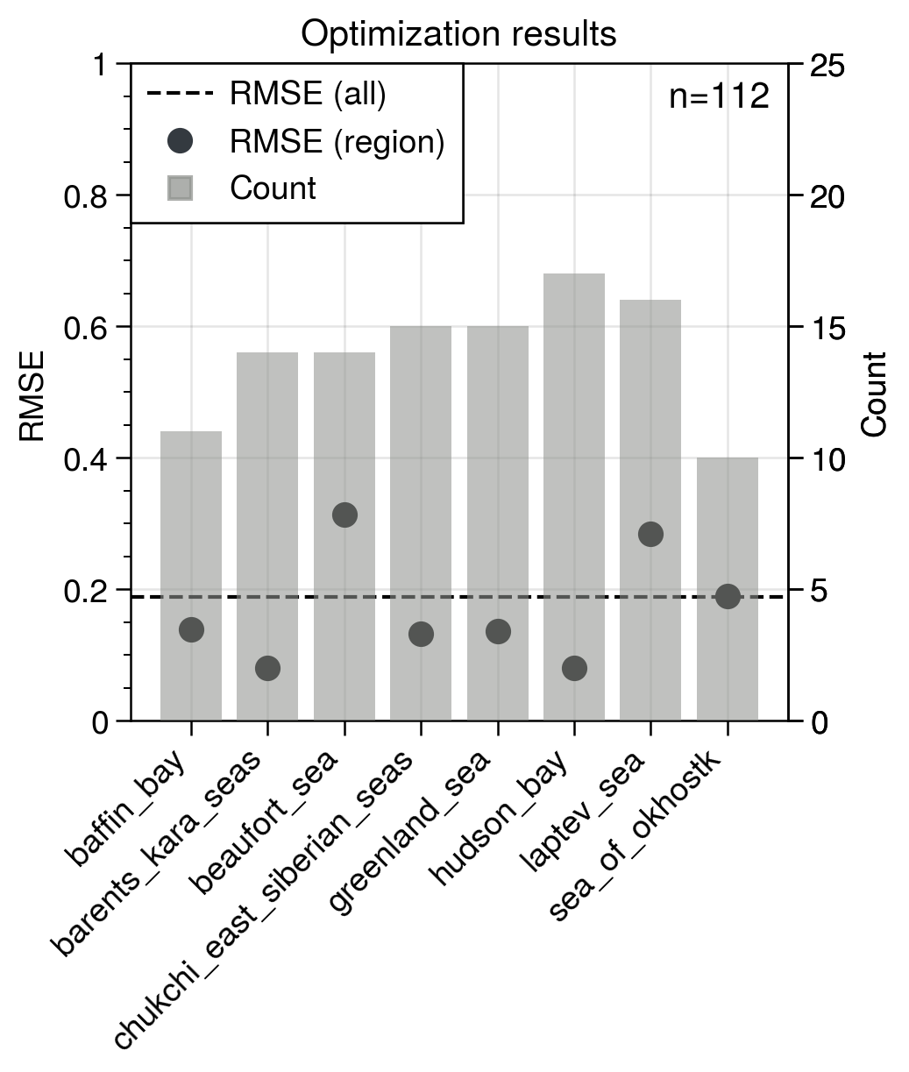
1. Cloud mask
The cloud mask functionality produces a binary image (clouds/not clouds). Fundamentally, however, we are actually creating 3 categories internally: opaque cloud, transparent cloud, and no cloud.
The algorithm does this by (1) applying a threshold to separate cloudy and clear pixels, then (2) using a pair of thresholds and a ratio test to set some of the flagged cloudy pixels as clear.
My approach:
Find the best performing threshold for identifying the total cloud fraction
Find the set of thresholds and ratios to maximize the number of “unmasked” floes while minimizing the total number of unmasked pixels.
Step 1 is conceptually the simplest as there is only one adjustable parameter. Initial results are based on the manually identified cloud fractions from the test dataset. This dataset is subject to human error but provides a baseline starting point for the analysis. The data show that the default threshold of 110 underestimates the total cloud fraction relative to the manual estimate.
For step 2, the optimization is more complex because it occurs across three parameters. There is also less available data: while the first step can use every image, the second step will be sensitive to the number of labeled ice floes.
Methodology: Divide the data into a testing and training set. 2/3 of images are randomly sampled to go into the training dataset. The remaining 112 images are used for testing. The training dataset is further divided at random into 5 groups for cross-validation. Cloud fraction (CF) is defined as the fraction of pixels in an image that are higher than the threshold.
Results: The left figure shows the root mean square error (RMSE) between manually estimated CF and calculated CF. The black line shows the default threshold of 110 and the dashed line is the average minimizing threshold (35) across the CV tests. On the right, we see the count per region and the RMSE for CF estimated using the optimal threshold by region (dots) and across the whole dataset (line).

Slide 7
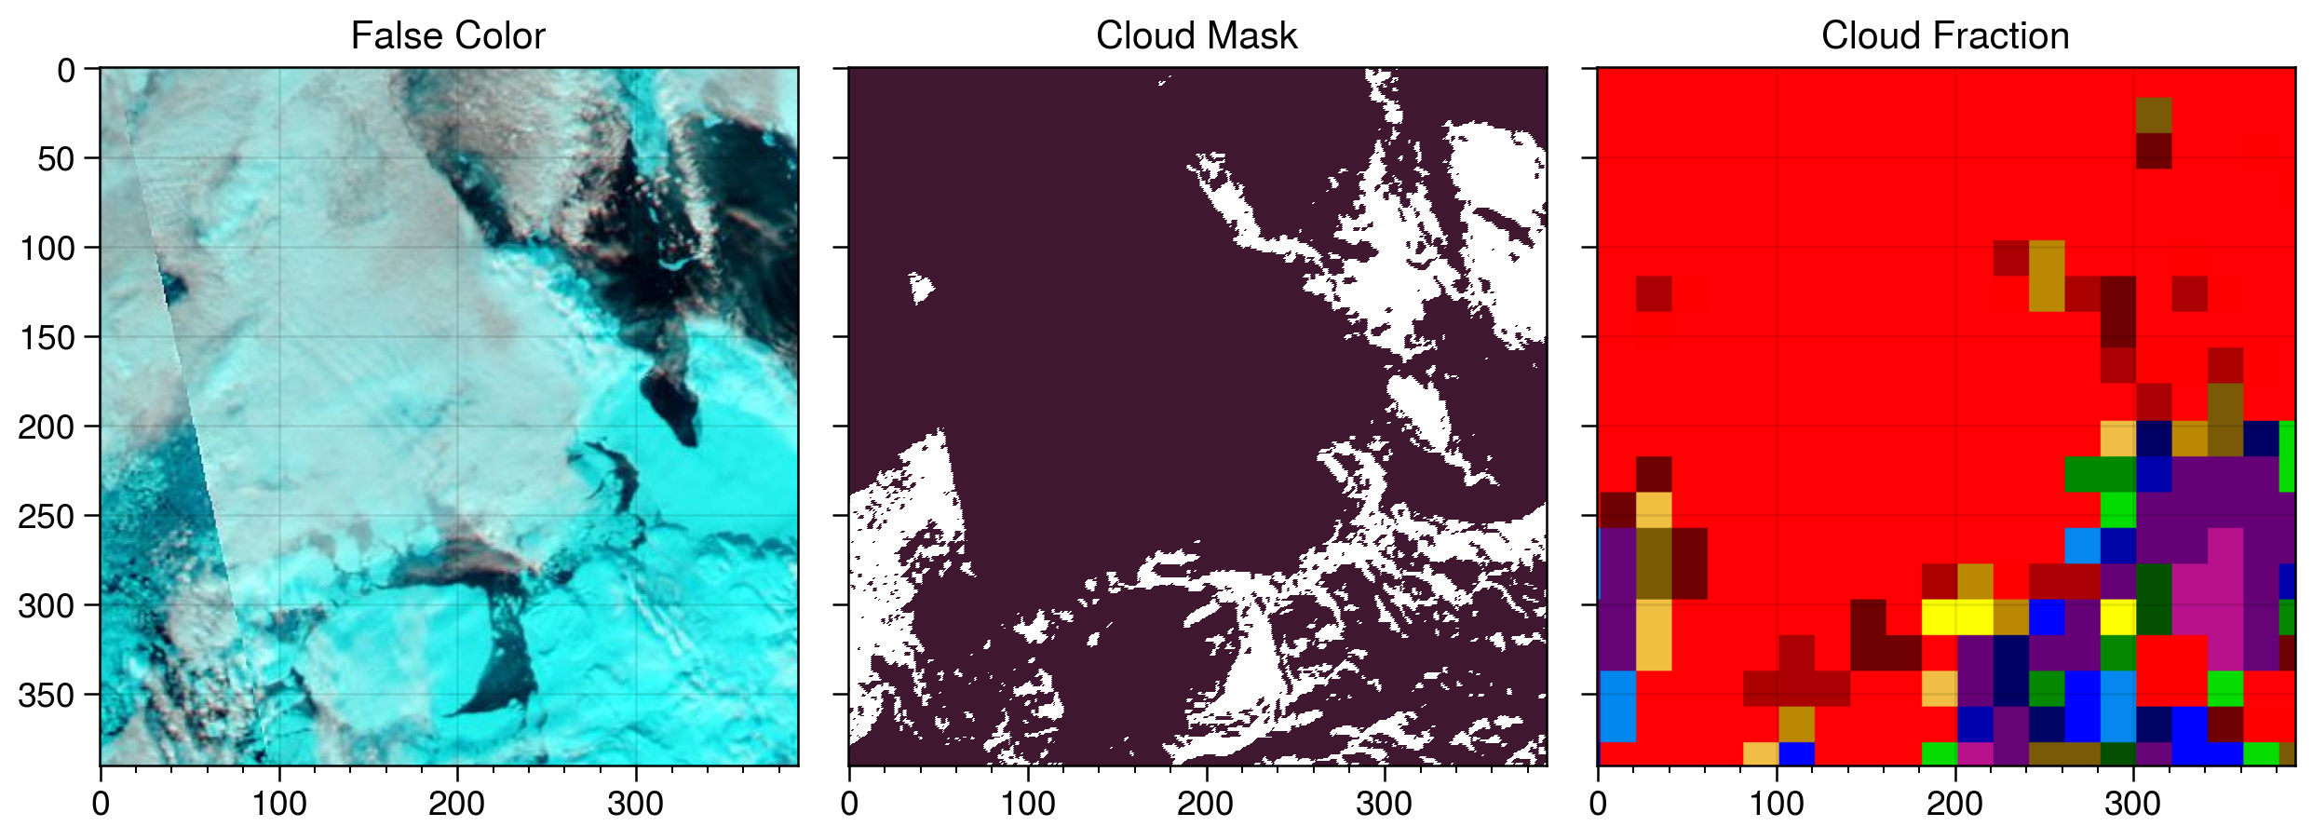
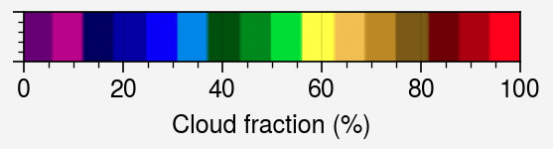
1. Improving the approach
A fundamental weakness of the prior approach is that the total cloud fraction estimate is subject to human error. While the images have been examined by multiple observers, we want to make sure that our optimized function is not biased by human biases.
The MODIS cloud fraction product
There is a validated MODIS cloud product that includes cloud fraction and cloud optical thickness. Unfortunately, for the snapshot mosaic imagery we are using for IFT, it is only available as colorized images (bottom right). This is the data that Ellen used. To get numerical data, we need to use the Level 2 imagery, which will not totally align with the images in our validation dataset. There are also some issues with data quality that affect the polar regions.
Options
Map the colors to fractions to allow direct comparison with the snapshot data. This is what I’ve done
Download Level 2 data for the cloud fraction and for the false color data, hoping that the color processing on the false color snapshots is the same as the Level 2 data
Case 021, Baffin Bay (Aqua, 2012-04-22). Left to right: False color image, cloud mask (total, prior to unmasking), and cloud fraction snapshot.

Slide 8
Cloud mask function: My interpretation from the text
The default cloud mask function operates only on the B2 and B7 channels from the false color image. It consists of thresholds, so we can shade regions showing the effect of each.
2b. B7/B2 < t3 → not cloud. Default t3 = 0.75
B7 pixel intensity
1. B7 > t0 → cloud. Default = 110.
B7 pixel intensity
B2 pixel intensity
B2 pixel intensity
2a. ( B7 < t1 ) & (B2 > t2) → not cloud. Defaults t1 = 200, t2 = 190
Final cloud mask obtained by removing pixels with 2a or 2b
B7 pixel intensity
B2 pixel intensity

Slide 9
Cloud mask function: As implemented in the MATLAB and Julia code
The text describes step 2b saying “Also, pixels with a ratio of [band 7/band 2] ranging from 0 to 0.75 were found to contain underlying ice floe features…”
As I figured out by looking closer at the code and the old MATLAB cloud masks, this “Also” is interpreted as a logical and instead of a logical or.
2b. B7/B2 < t3 → not cloud. Default t3 = 0.75
B7 pixel intensity
1. B7 > t0 → cloud. Default = 110.
B7 pixel intensity
B2 pixel intensity
B2 pixel intensity
2a. ( B7 < t1 ) & (B2 > t2) → not cloud. Defaults t1 = 200, t2 = 190
Final cloud mask obtained by removing pixels with 2a and 2b
B7 pixel intensity
B2 pixel intensity

Slide 10
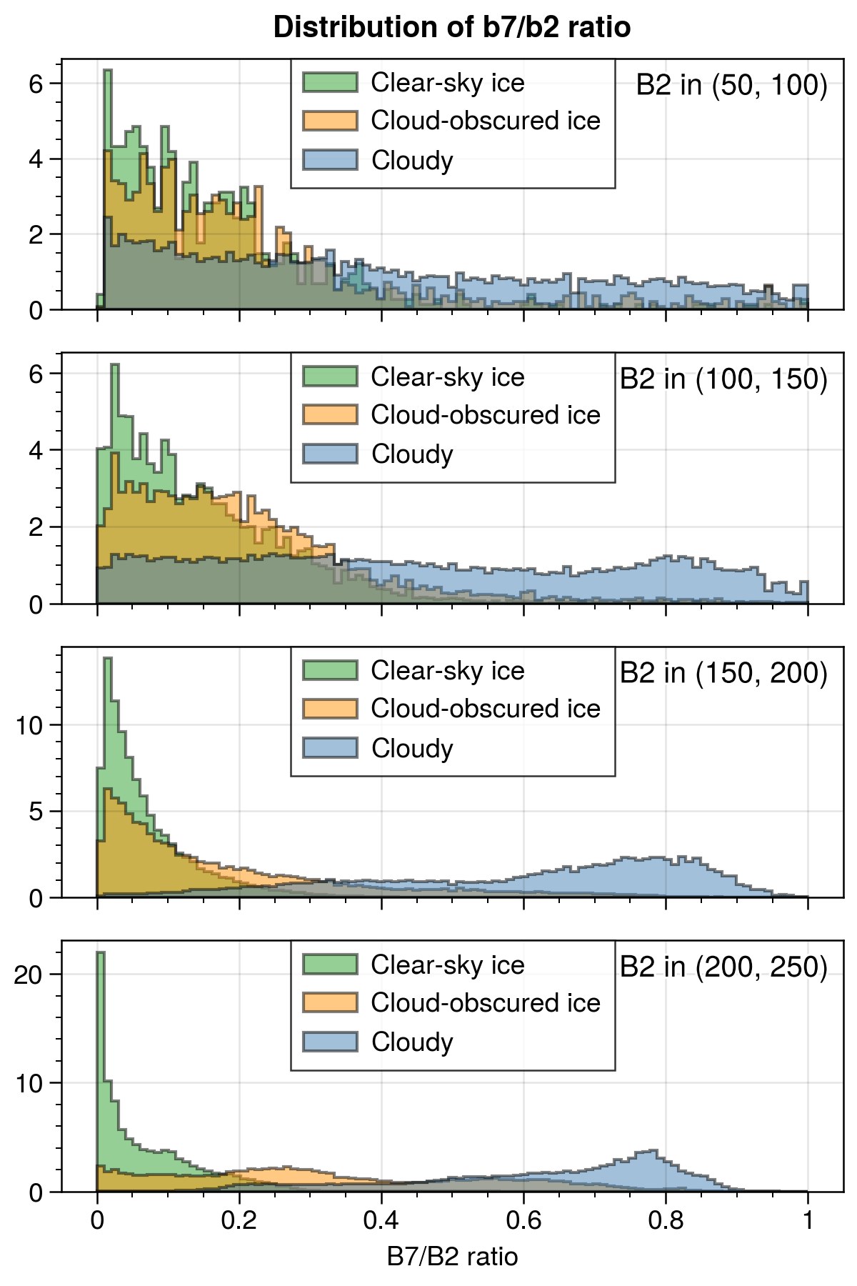
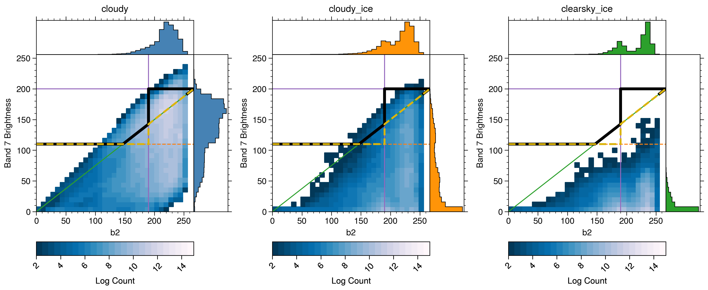
Estimating B2-B7 relationship from data
I separated cases by 2/3 training 1/3 split, then compiled pixels from each of the images into sets for the following three categories
Cloudy
No visible sea ice
No visible landfast ice
Manual category = “Opaque”
Land = False
MODIS cloud fraction > 10%
Cloud-obscured ice
Intersection of floe and landfast ice labels with MODIS cloud mask where cloud fraction > 10%
Only cases where metadata says clouds over floes are ransparent or nearly transparent
Clear-sky ice
Labeled ice floes and landfast ice
MODIS cloud mask is less 10%
Left: Log-scaled 2d histograms (shading) and unscaled marginal distribution (panels) for band 7 and band 2 corrected reflectance. Above: B7:B2 ratios by Band 2 bin. Note the similarity between Clear-sky and cloud-obscured ice in most bins. Default parameter is 0.75.

Slide 11
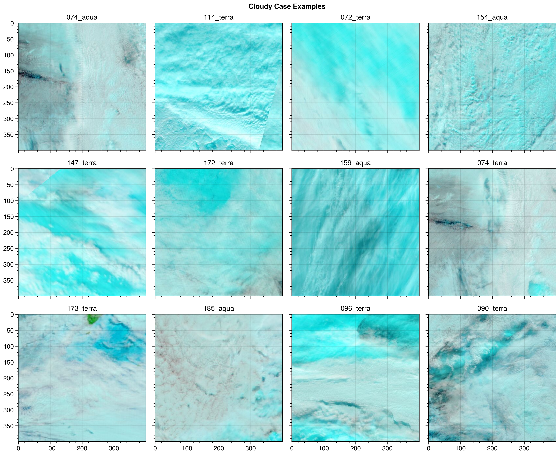
Estimating B2-B7 relationship from data
Example test cases
Notes:
TBD: check if the band 7 0 pixels are where the mask is not well-aligned
Note: histograms in panels are not log-transformed, histogram in main panel is log transformed.

Slide 12
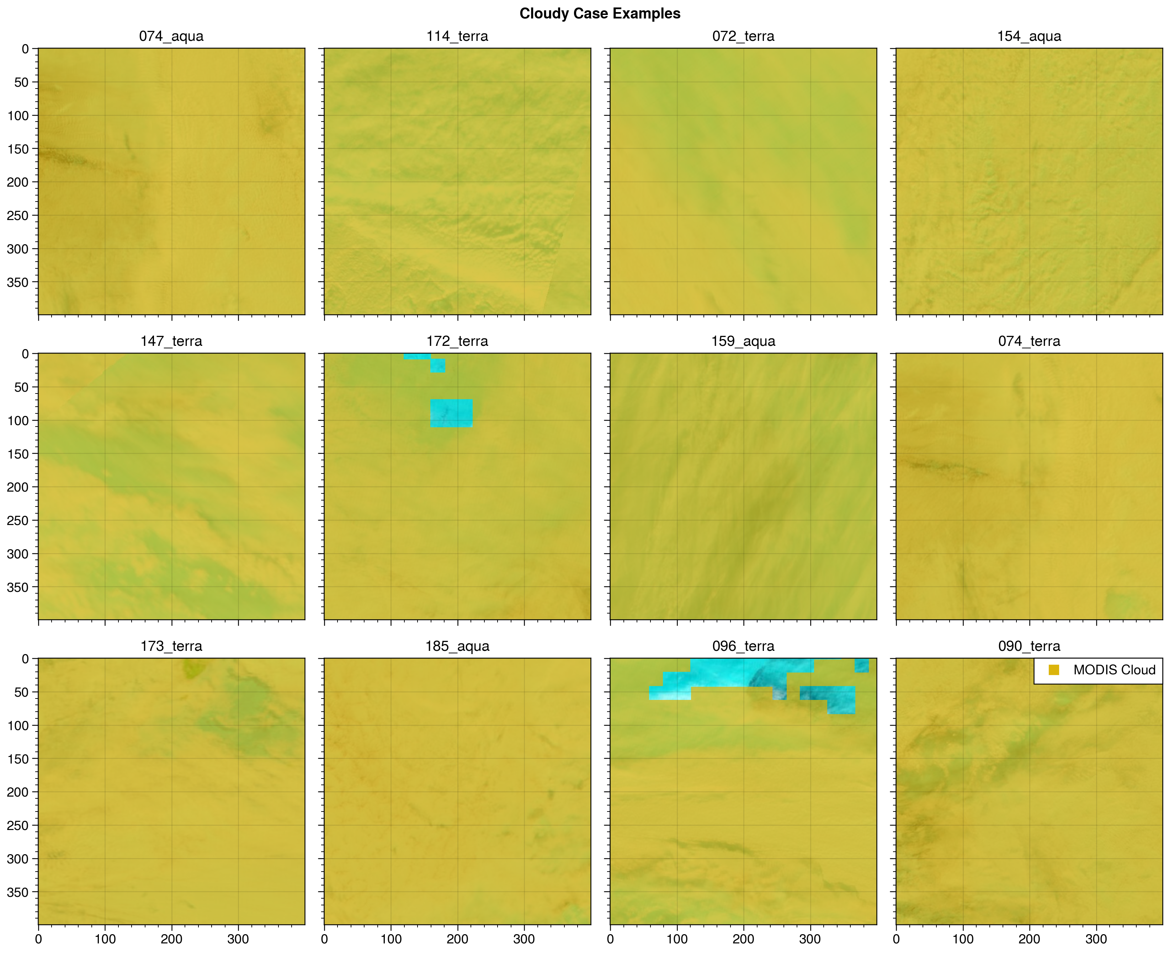
Estimating B2-B7 relationship from data
Example test cases
Overlay: MODIS cloud
fraction over 20%
Notes:
TBD: check if the band 7 0 pixels are where the mask is not well-aligned
Note: histograms in panels are not log-transformed, histogram in main panel is log transformed.

Slide 13
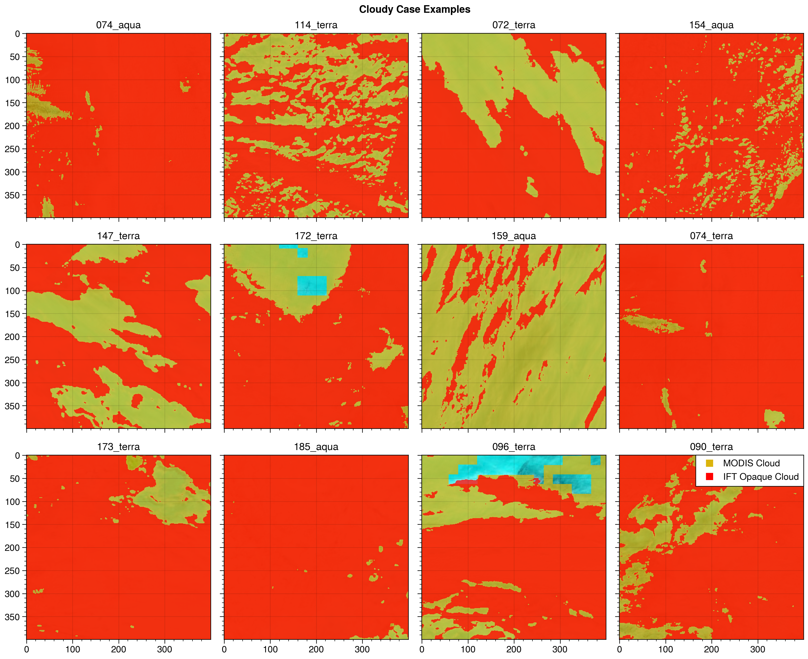
Estimating B2-B7 relationship from data
Example test cases
Overlay: MODIS cloud
fraction over 20% (gold)
IFT opaque cloud, original
algorithm
Notes:
TBD: check if the band 7 0 pixels are where the mask is not well-aligned
Note: histograms in panels are not log-transformed, histogram in main panel is log transformed.

Slide 14
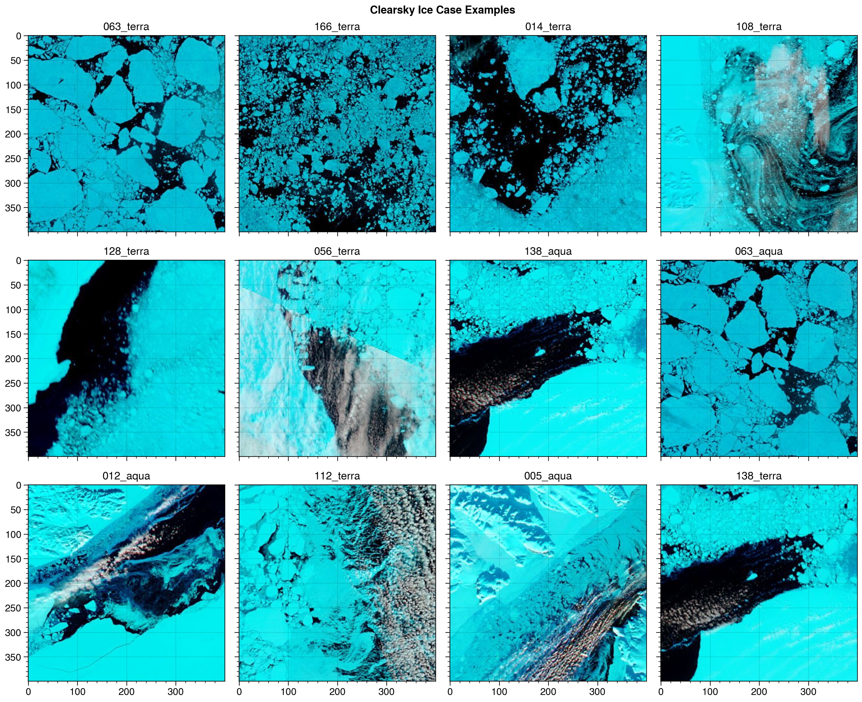
Estimating B2-B7 relationship from data
Example test cases
Images with large-ish
number of clear-sky sea ice
pixels
Notes:
TBD: check if the band 7 0 pixels are where the mask is not well-aligned
Note: histograms in panels are not log-transformed, histogram in main panel is log transformed.

Slide 15
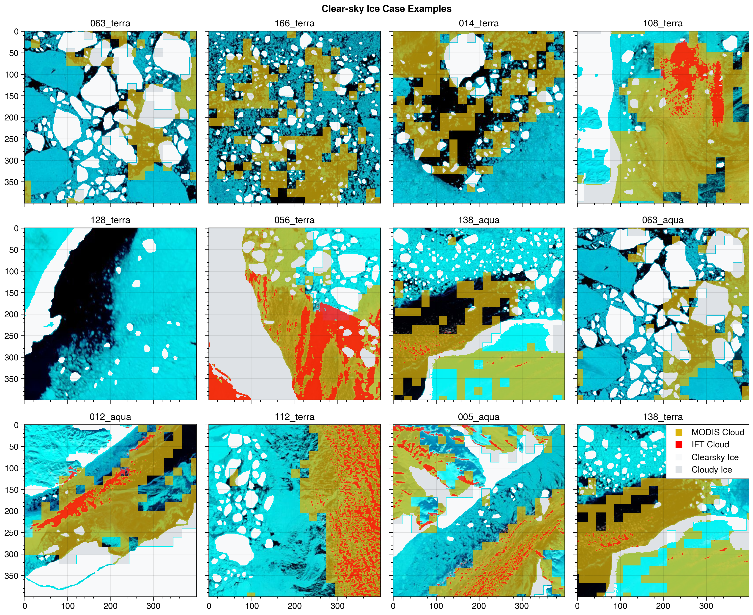
Estimating B2-B7 relationship from data
Example test cases
Images with large-ish
number of clear-sky sea ice
pixels
Overlays:
Gold: MODIS cloud > 20%
Red: IFT original cloud mask
White: Clear sky ice
Gray: Ice under thin clouds
Note: this is for sanity-check
visualization only. The histograms
are built with selected pixels from
images, not from entire images.
Notes:
Potential to add more ice masks where the floes intersect the edges

Slide 16
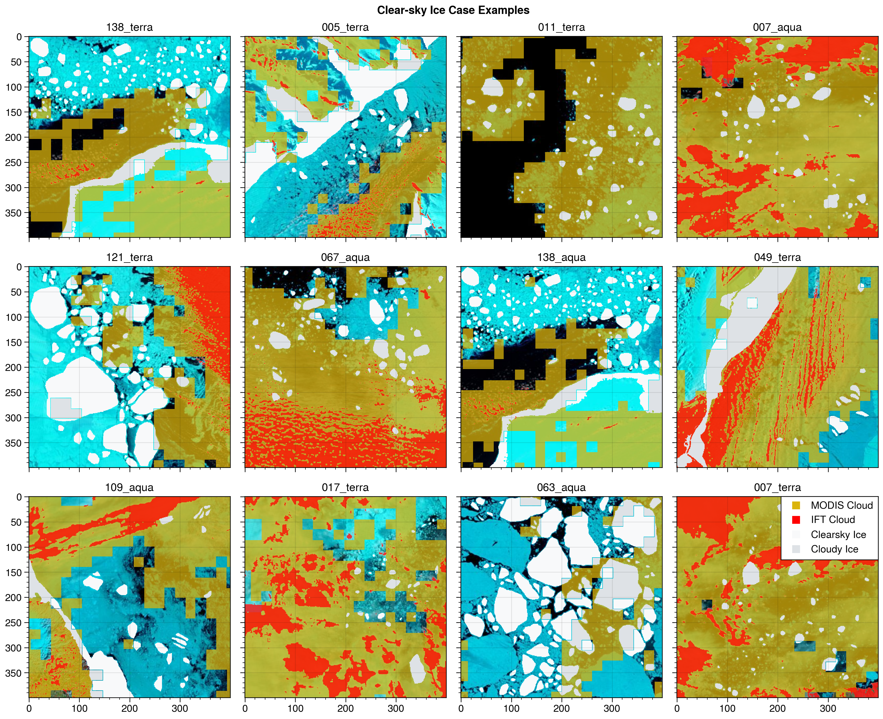
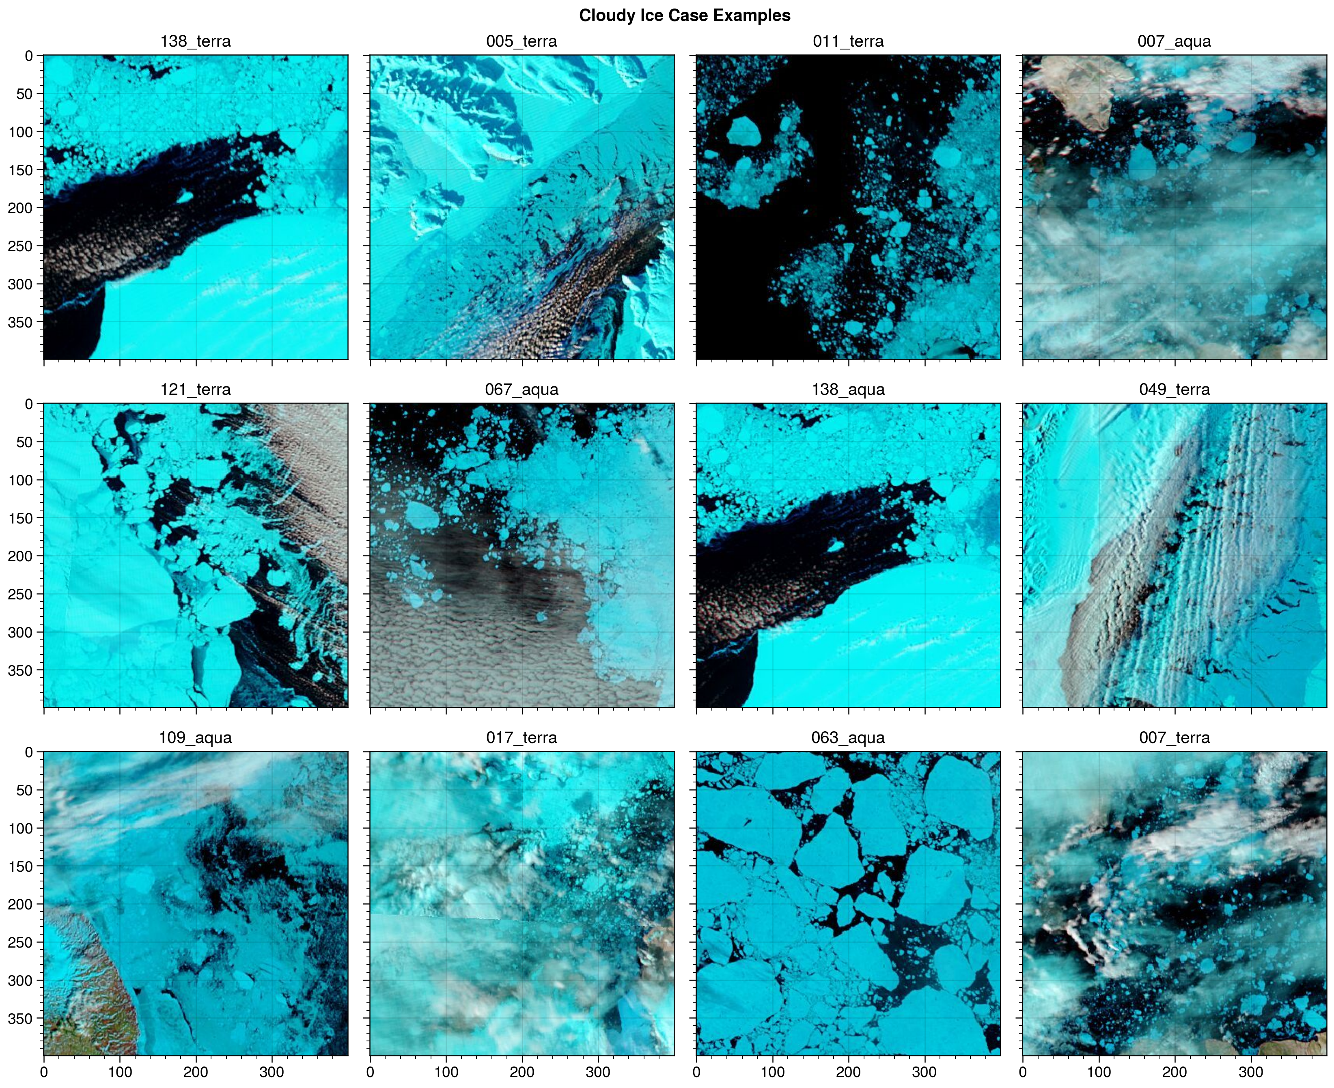
Estimating B2-B7 relationship from data
Example test cases
Images with large-ish
number of cloudy sea ice
pixels
Overlays:
Gold: MODIS cloud > 20%
Red: IFT original cloud mask
White: Clear sky ice
Gray: Ice under thin clouds
Note: this is for sanity-check
visualization only. The histograms
are built with selected pixels from
images, not from entire images.
Notes:
Potential to add more ice masks where the floes intersect the edges

Slide 17

Estimating B2-B7 relationship from data
Example test cases
Images with large-ish
number of cloudy sea ice
pixels
Overlays:
Gold: MODIS cloud > 20%
Red: IFT original cloud mask
White: Clear sky ice
Gray: Ice under thin clouds
Note: this is for sanity-check
visualization only. The histograms
are built with selected pixels from
images, not from entire images.
Notes:
Potential to add more ice masks where the floes intersect the edges

Slide 18
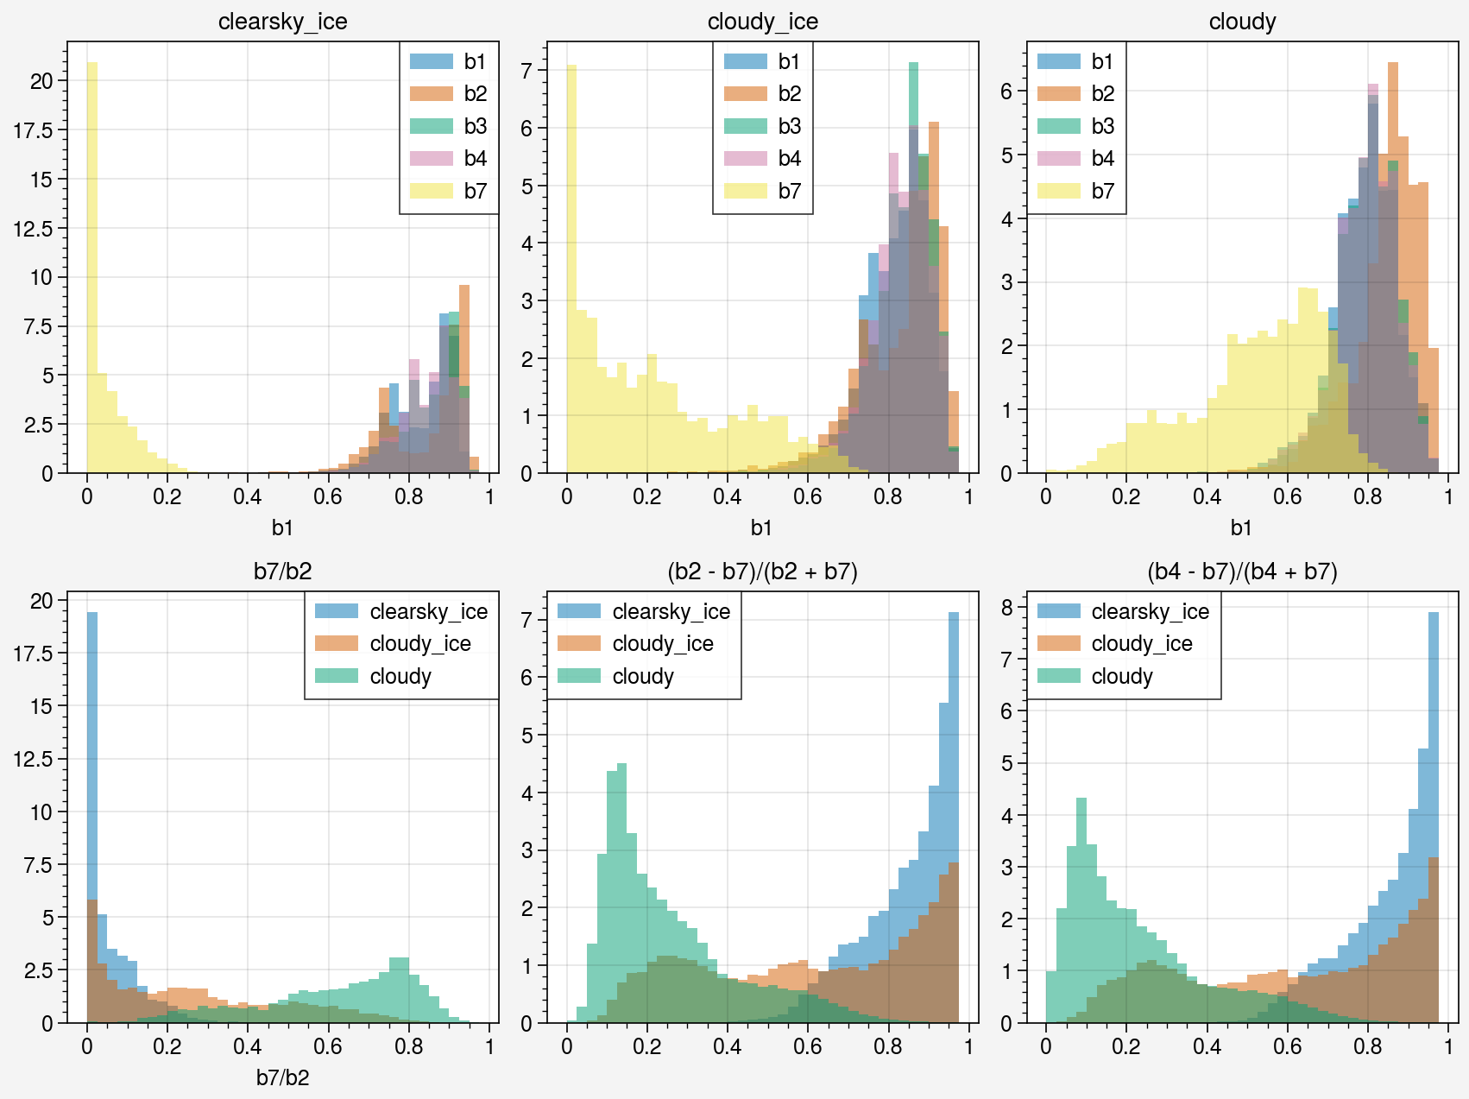
Reflectance at different bandwidths
Relationships between surface type and
reflectance distribution
Most of the distinction in the clouds vs ice is happening in the b7/b2 ratio
This is very similar to the standard measure “Normalized Difference Snow and Ice Index”: NDSI = (Vis – IR)/(Vis + IR)
For M(ODIS: common to use band 2 or band 4 for the visible band
Notes:
Potential to add more ice masks where the floes intersect the edges

Slide 19
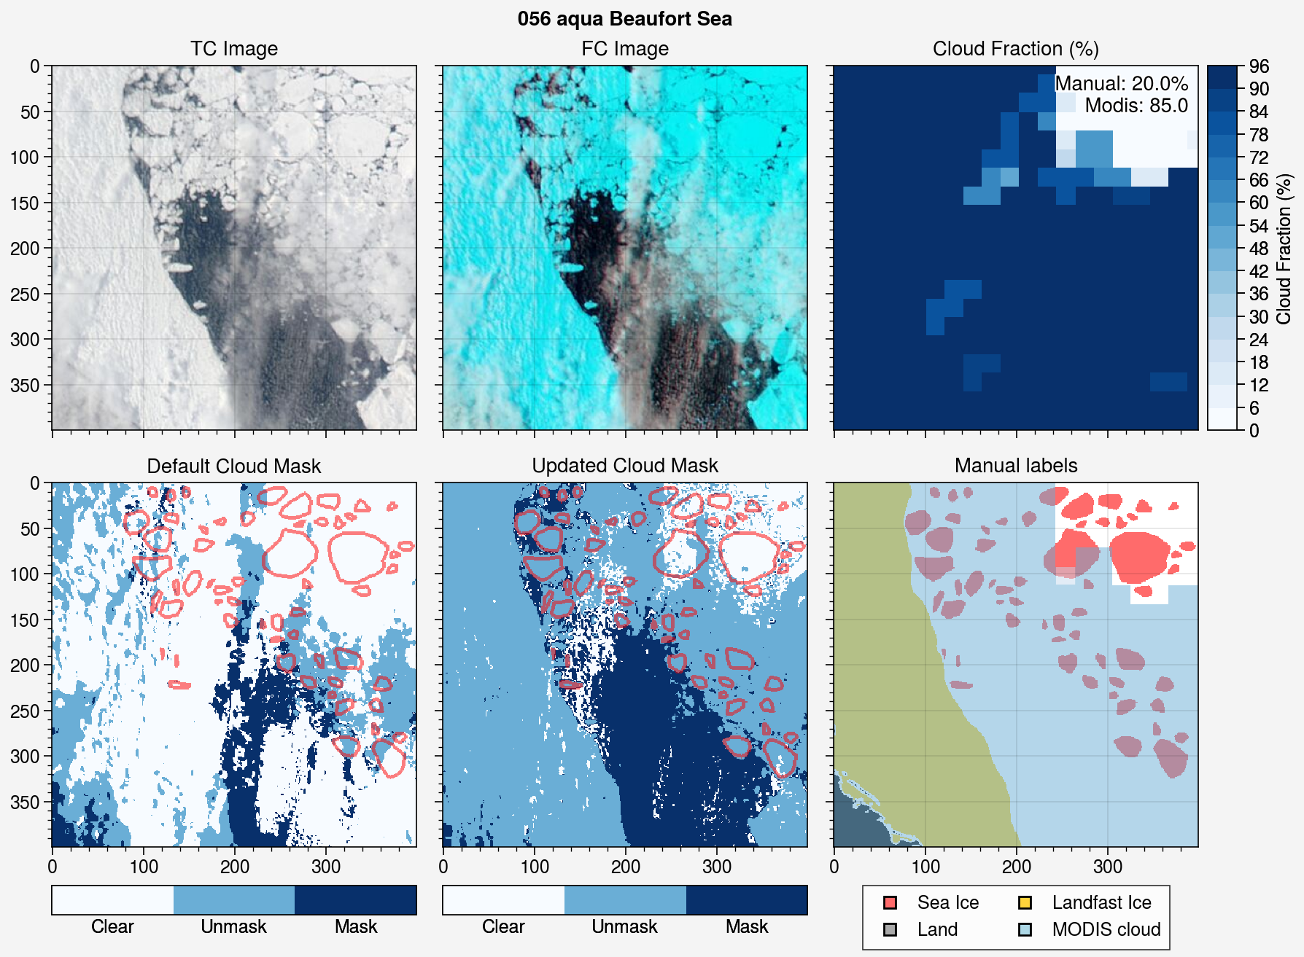
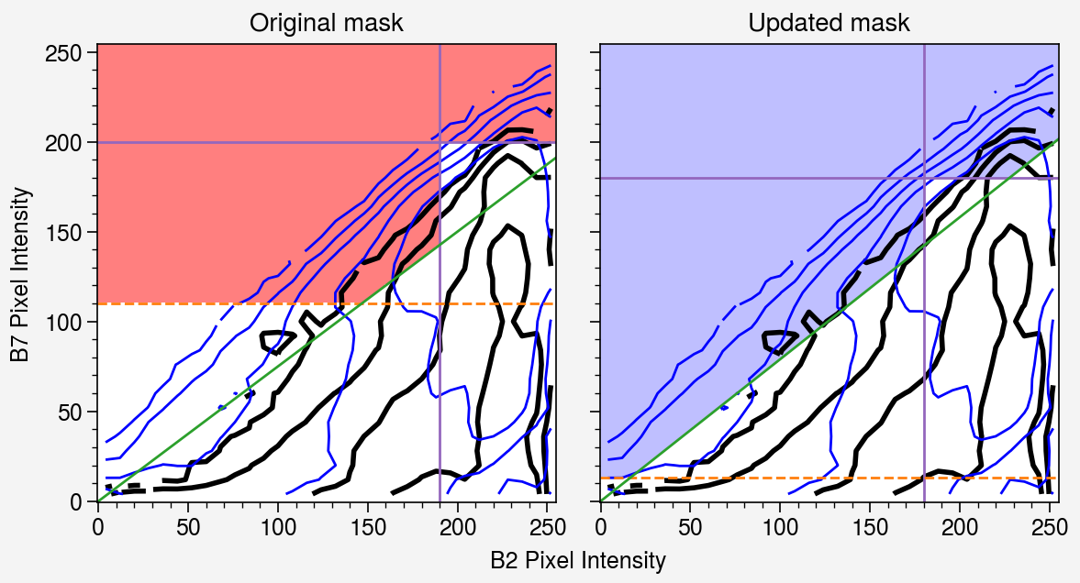
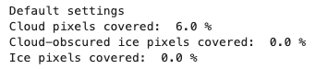
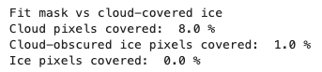
Example:
Quantile method
Fitted to the cloud-covered ice pixels
Thresholds = 13, 180, 180, 0.8
Looking for methods for deciding balance between strict and lax masking, weighting options with clear-sky and cloudy ice pixels
Notes:
How well-separated are the categories “Sea ice under cloud” and “Ocean under cloud”?

Slide 20
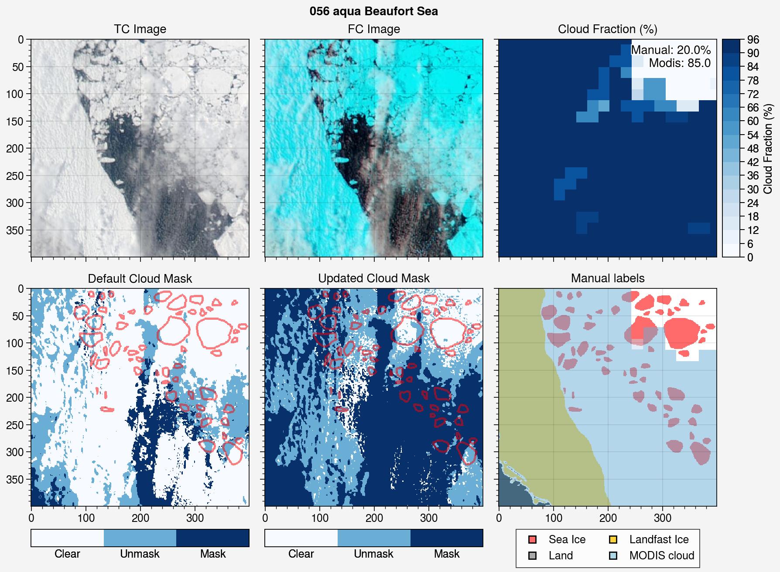
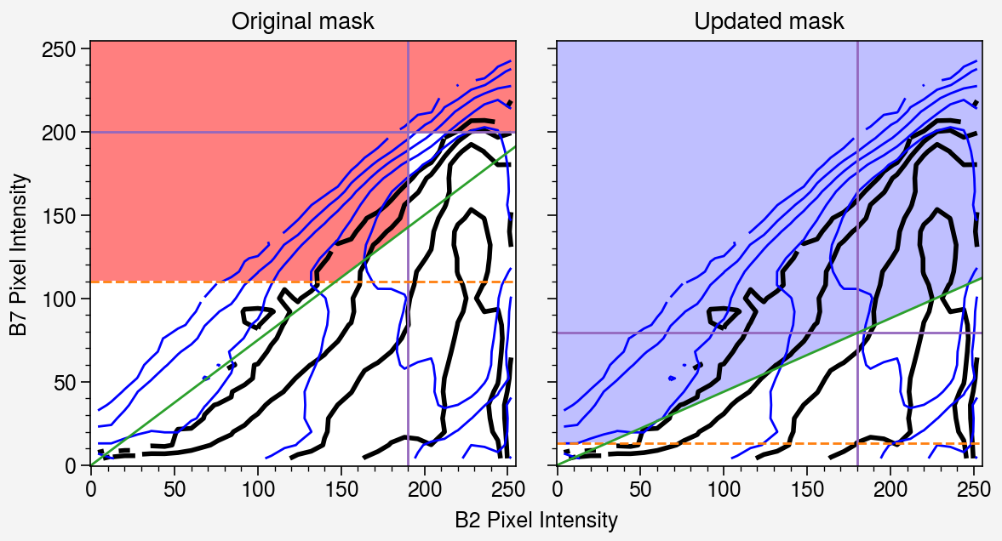
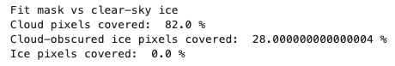
Example:
Quantile method
Fitted to the clear-sky ice pixels
Thresholds = 13, 180, 80*, 0.4
Looking for methods for deciding balance between strict and lax masking, weighting options with clear-sky and cloudy ice pixels

Slide 21
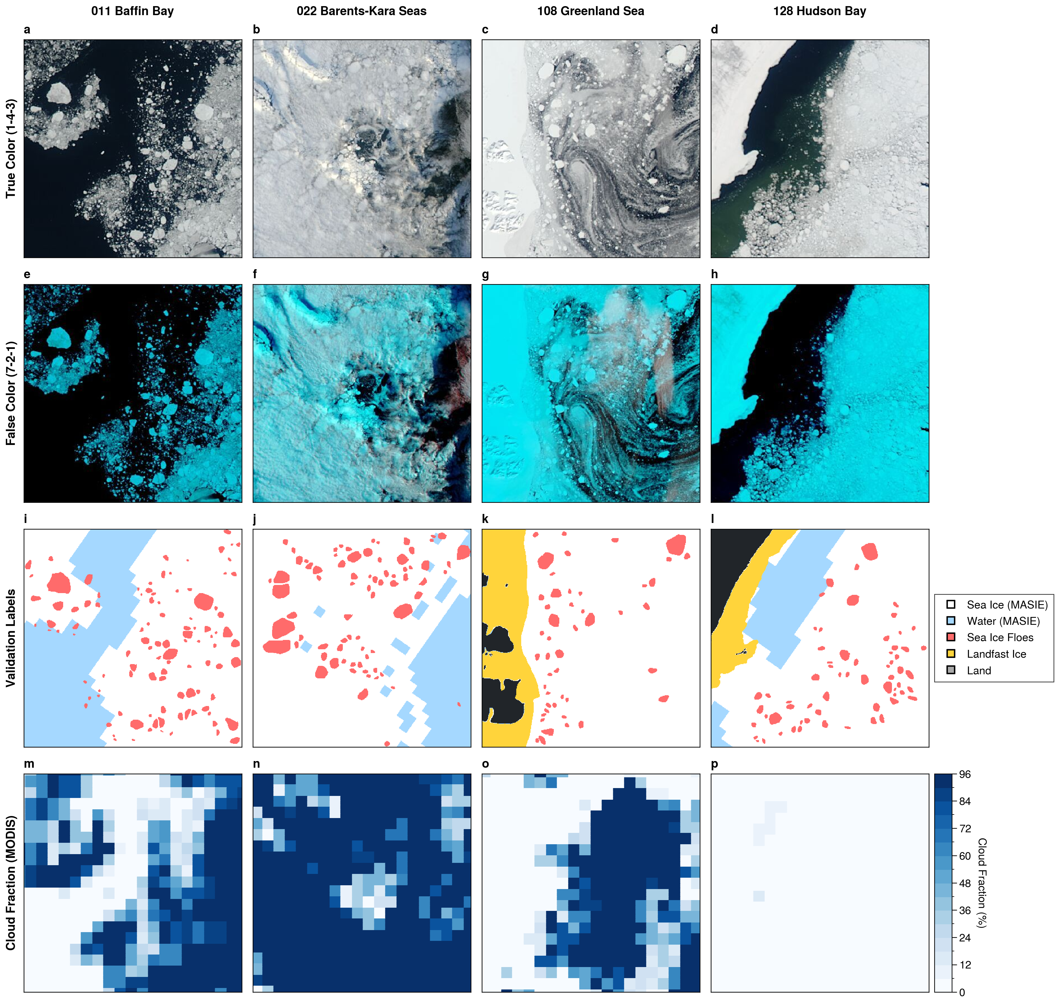
Example figure to describe the validation dataset. The images should show how an alternative cloud mask is needed.
Notes:
Potentially should add

Slide 22

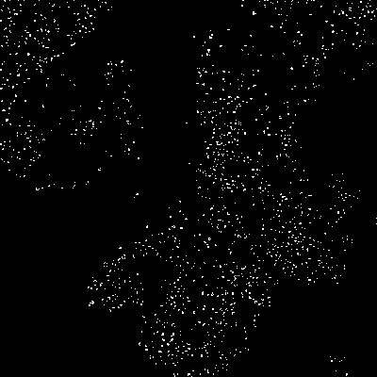
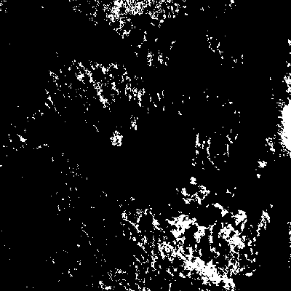
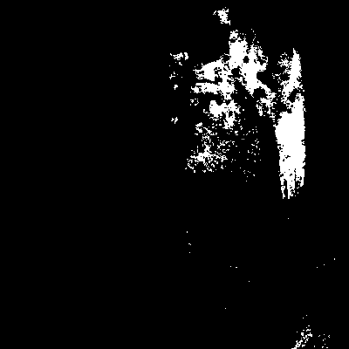
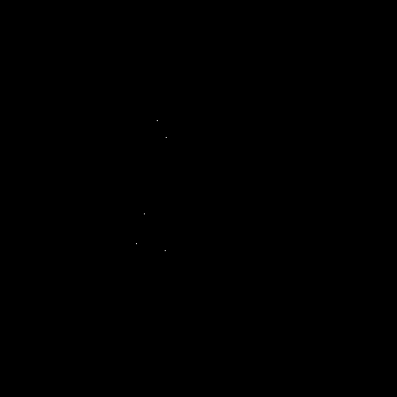

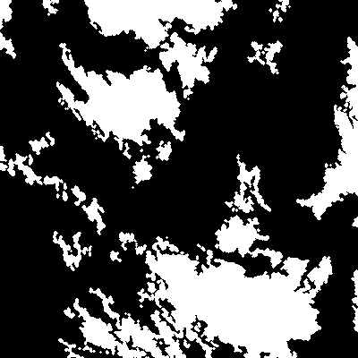
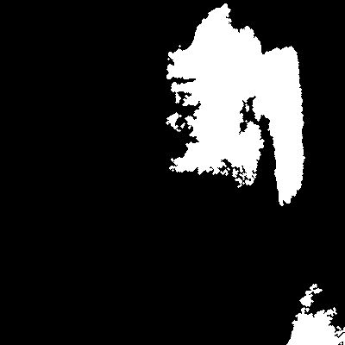
011
Original LA2019
The updated cloud mask parameters give better agreement with cloud fractions. However, threshold-based methods result in speckle.
Cleaned update:
opening -> markers -> reconstruction -> opening -> imfill
011
022
108
128
Updated: better cloud fraction, worse speckle
Notes:
Potentially should add

Slide 23
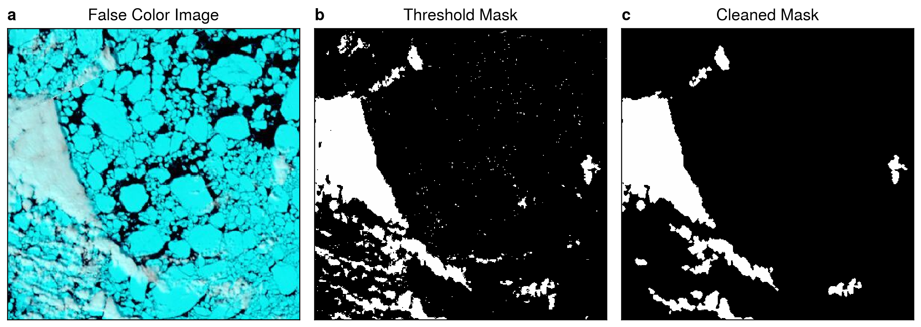
Cleaned mask routine in action

Slide 24
2. Preprocessing
Questions
What objective metric can we use to evaluate the quality of choices here?
Parameters available to optimize
Number of tiles (overall and within the histogram equalization)
Thresholds for the entropy and BW for applying histogram equalization
Size of the structuring elements
Settings for the sharpening algorithm (Gaussian radius, sharpening intensity)
Challenges
Global parameter sweeps are expensive when there are many parameters to test.
Defining a cost function: what can we use use to measure success?
This step will affect the success of the segmentation, however the best performing parameters for the segmentation algorithms are also likely to depend on the quality of the preprocessing routines.
One idea: testing the contrast at object edges (floes, landfast ice) against the contrast within objects. Edge contrast should be maximized while interior contrast should be minimized.

Slide 25
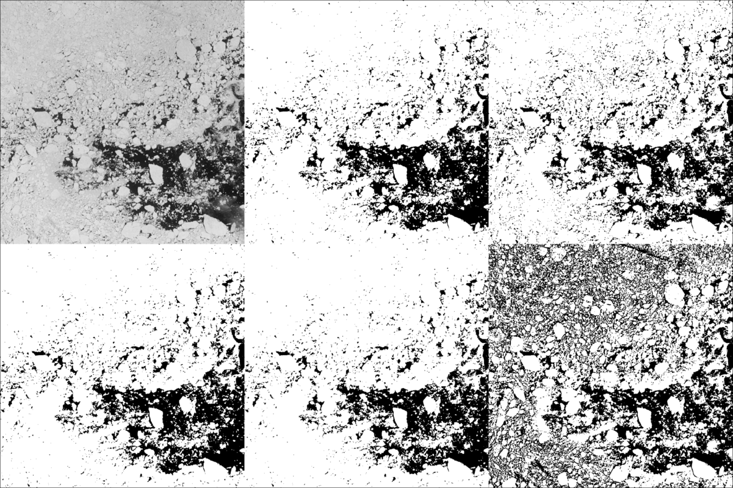
3. Semantic segmentation (ice/water discrimination)
Lopez-Acosta 2019 Tiling algorithm uses adaptive threshold binarization, which generally does well at picking the brightest objects. It is sensitive to the threshold window size.
grayscale
polysegment
adaptive: p=15
Goals for binarization
Simple map of ice vs water?
Ice floes vs water AND unresolved ice?
Binarization algorithms
The updated API allows us to easily use alternative binarization methods, including several common algorithms, and to adjust parameters of each. Otsu, PolySegment, and Intermodes are frequently used methods for sea ice because they assume a bimodal image histogram; they vary in how the division between image modes are chosen. These methods are good for ice/water masks but are less good for identifying ice floes. The adaptive method looks at a histogram within a window a draws a line based on percentile. By default, things 15% below the average are set to black (top right). Ellen’s algorithm used this method strictly using the average, which to my eye looks like a better result.
otsu
intermodes
adaptive: p=0

Slide 26
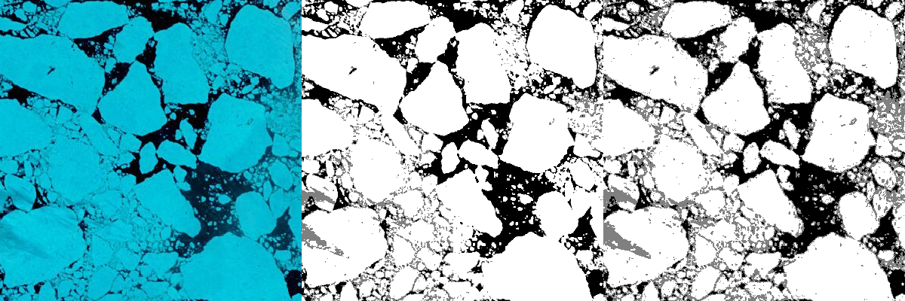
063 Aqua. Falsecolor, tiled adaptive + ½ otsu, ice peaks intermodes + ½ otsu
It looks to me from this image at least (063, a nice clear-sky case) that the Otsu algorithm is great at distinguishing ice and water, while the binarized adaptive threshold picks out the bright floes. The IcePeaks method is more selective, but has worse performance with the speckle and noise on the sea ice surface. In either case, it may be that we can use these levels to assist in the segmentation.

Slide 27
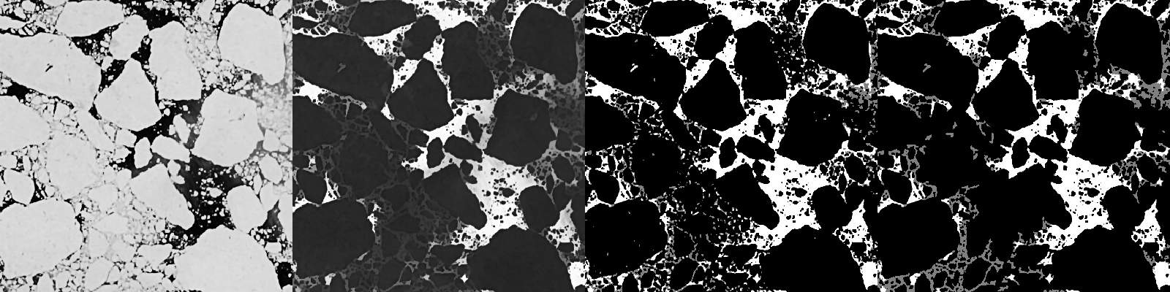
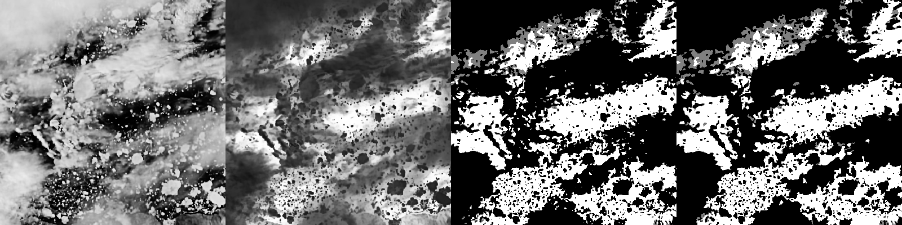
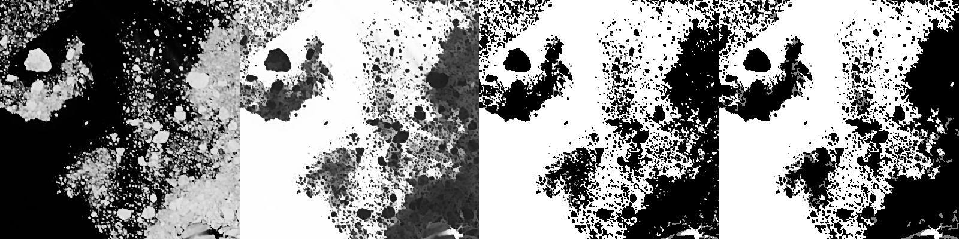
Preprocessing
diffuse
sharpen
adjust histogram
G = contrast stretching
R = reconstruction of G
Initial classification
I/W = Otsu()
Floe/Ice = AdaptiveThreshold()
Works well with even lighting, if the clouds aren’t masked there’s an issue (e.g. image 7).
63
7
11

Slide 28
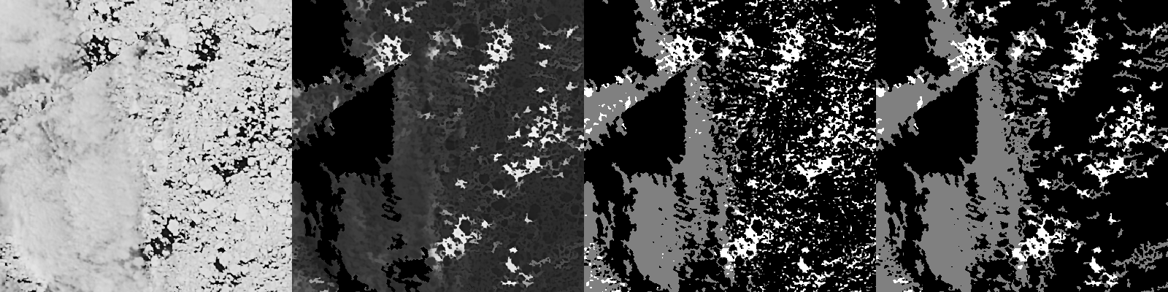
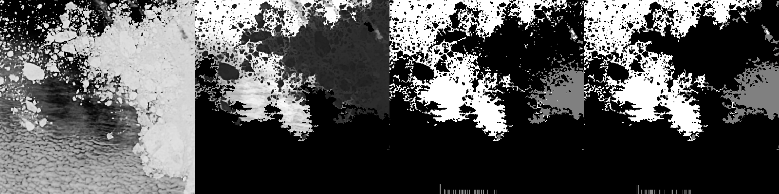
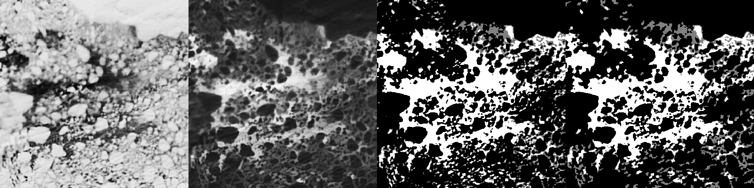
Preprocessing
diffuse
sharpen
adjust histogram
G = contrast stretching
R = reconstruction of G
Initial classification
I/W = Otsu()
Floe/Ice = AdaptiveThreshold()
Images on the right test the difference with using G and R for the initial classification.
In case 43 (aqua), applying the cloud mask before fitting the binarization works well. Case 95 is fully cloudy – using a stronger adaptive equalization is effective. However, this only works if the clouds are very thin.
43
67
95

Slide 29
4. Object-based segmentation
Uncertainty in feature parameters
Quality of the shape detection
Perimeter, centroid, area – propagating uncertainty due to digital representation
Set of metrics for callibration
Under/over segmentation
Area mismatch
Non-detection

Slide 30
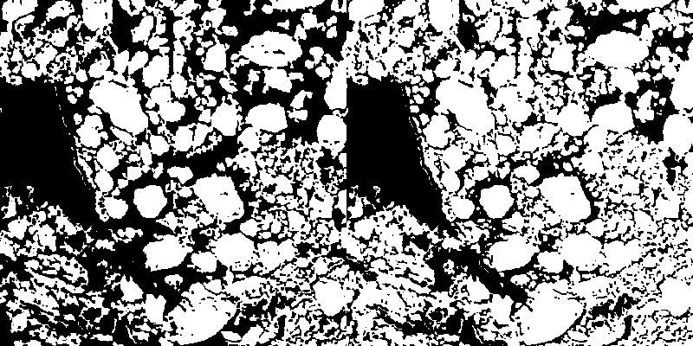
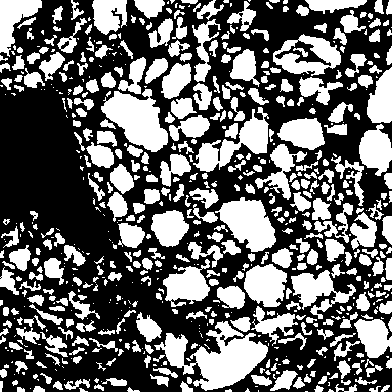
k-means binarization
tiled adaptive binarization
reconstruction and local max filter
Only minor differences between the the k-means and tiled approach for this image, one where the floes are relatively easy to separate. The k-means method gets boundaries separated better, but also adds holes on the inside. These holes, in turn, can cause problems for the watershed transformation. Using the fillholes! function works pretty well in this case. In the LopezAcosta2019Tiling workflow, watershed1 is applied to both of these images separately, then the boundaries of the watershed regions are joined.
This method is used prior to the watershed 2 method. There is a two-step image reconstruction method, then regional_max. In the code, there is also a series of steps to compute gradients and impose minima using this as a starting point, and combining it with the previous watershed boundaries. The success of the watershed method depends on the quality of the selected marker elements. When the markers are messy, and when there are holes within the shapes, the watershed boundaries are poort.

Slide 31
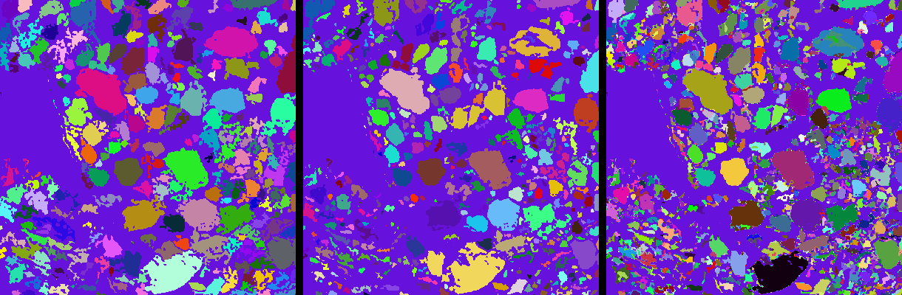
The left two images are watershed results that come from the k-means and the local max methods, respectively. One approach for segmentation is to use multiple methods to segment the image, then select the regions that are linked together in multiple segmentation results. This is similar to the idea in the Lopez-Acosta method of joining the boundaries, but here the region boundaries may actually touch. The far right image is a simple sum of region labels that are then relabeled – it is in essence the intersection of segmentations. For this result to be useful, it becomes necessary to evaluate the quality of each segment with reference to the original image, and use some kind of decision rule to determine which of the candidate shapes should be used in the final segmentation. This should involve weighing whether the shape boundaries align with gradients in the image, or if the boundary is rather arbitrary.
I’ll note also that there is likely a need for another step where shapes are eroded, relabeled, and dilated. Testing each shapes circularity or solidity, for example, would be helpful.

Slide 32
5. Tracking
Reconciling the 2019 paper and the translated MATLAB code
There are numerous places where the algorithms differ, and a lot of it probably represents innovations from Rosalinda during the course of her PhD work. Nevertheless, it is important that we are clear about whether the method referenced in the 2019 paper is being used, or an update of the method is being used.
Floe size limited to between 44 km2 and 940 km2. (704 to 15040 pixels)
Inconsistent minima through the paper; e.g. in segmentation 1 km2 and 3 km2 are mentioned as minimum sizes.
Reasoning given is that “the standard deviation of [geometric] parameters decreases by an order of magnitude”
Length scales for 44 km2 is 6 km; paper says retrieved floes are 8-65 km.
Increasing the tracking to smaller floes is a major reason for updating the methods!
Floe matching occurs in two steps: less than 24 hours, then less than 48 hours
New version does it all at once
Time/distance thresholds – I updated the code to reflect the thresholds in the paper.
Similarity measures are assessed from “one trajectory point to the next”, implying the measures are normalized by floe1 area.
Using the absolute difference ratio makes the measurement a metric, as it enables the measure to be symmetric. floe1 -> floe2 percent differences is now the same as floe2 -> floe1.
We experimentally verified that the major/minor axis vary less across segmented shapes than do the area and convex area.
For the next version: could do combined measurements: solidity, major/minor axis ratio.
Shape difference is calculated before the psi-s curve. Is it a faster or slower computation, since the psi-s curves are already generated? I would guess slower.
Calculation of psi-s correlation
We use the DSP cross corr function, which should be equivalent to pearson correlation
We find that 70% correlation is way too low a bar – for an example image with 165 floes, and taking the first floe as a comparison point, 82% of the other floes have psi-s correlation greater than 70%.
The original IFT method is purely a feature matching algorithm and uses shape-matching of binary segmentation results. This method works well for large floes with unique shapes, but is prone to error when floes have similar shapes to their neighbors. Extensive post-processing is required to extract quality trajectories.
My fear is that this method is old and outdated, and that most other ice tracking has moved on to modern algorithms like A-KAZE and ORB, sometimes with feature tracking as a step along the way. For this paper, we’ll do what we can with the shape matching and geometric methods. Perhaps later, we can train a method such as HOG for different size ranges of sea ice floes.

Slide 33
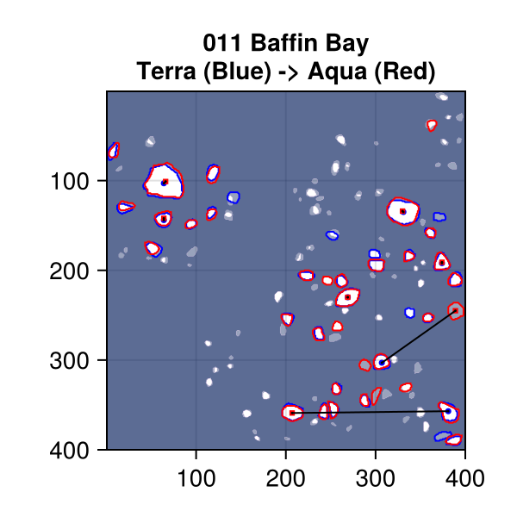
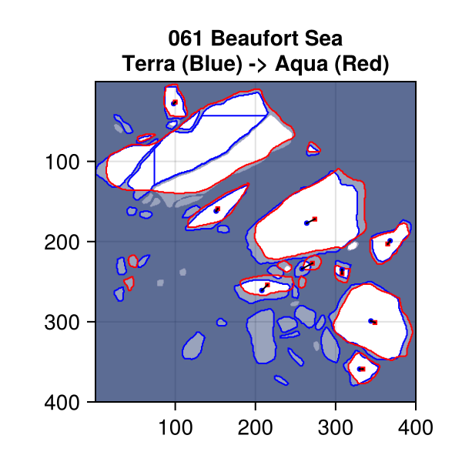
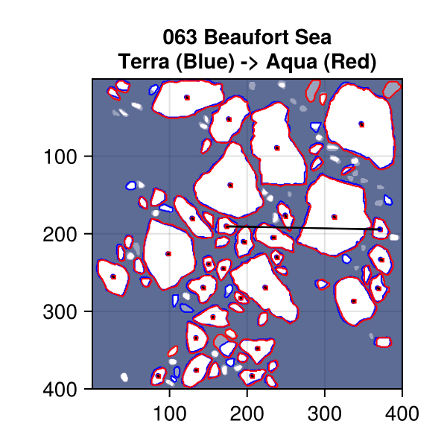
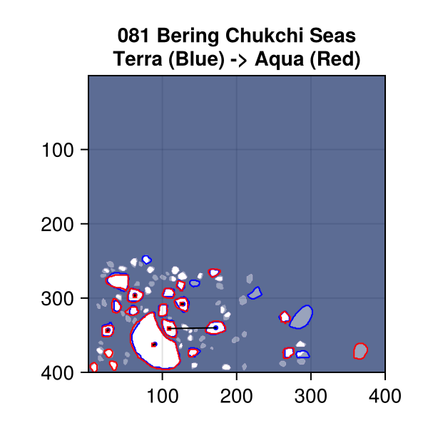
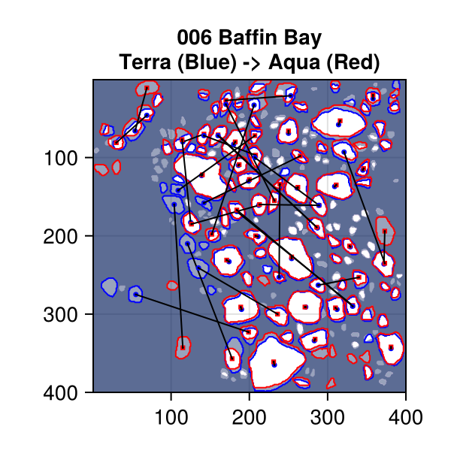
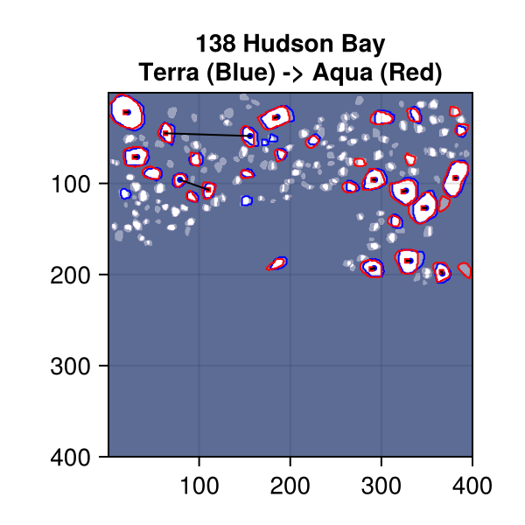
5. Tracking: Examples of status quo
In most cases, the results are reasonable (006 being an exception). Feature tracking usually results in some stray vectors that can be cleaned by comparison with neighbors.
Questions to figure out:
Can we retain multiple matches so we can pick the best one?
How does the issue change if smaller floes are included?
Notes:
6: poor results for about half of the floes.
11: two swapped floes
61: weird result in the contours, perhaps error in binary image or the boundary computation? Mostly decent results though.
63: good results, mainly – one swapped floe (bidirectional).
81: mostly good result, one swapped floe.
138: one failed pairing, mostly good results.

Slide 34
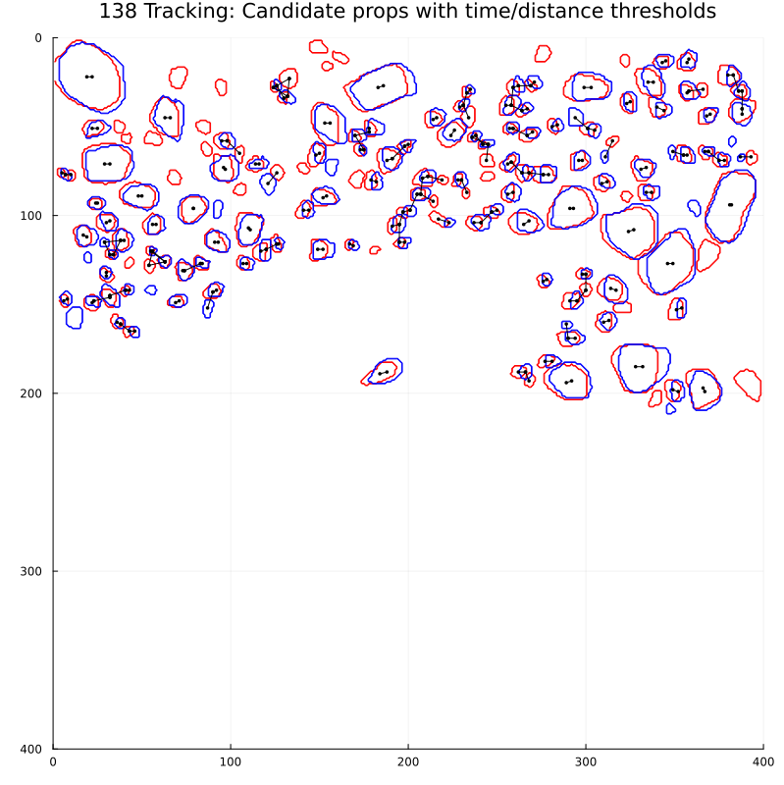

Slide 35
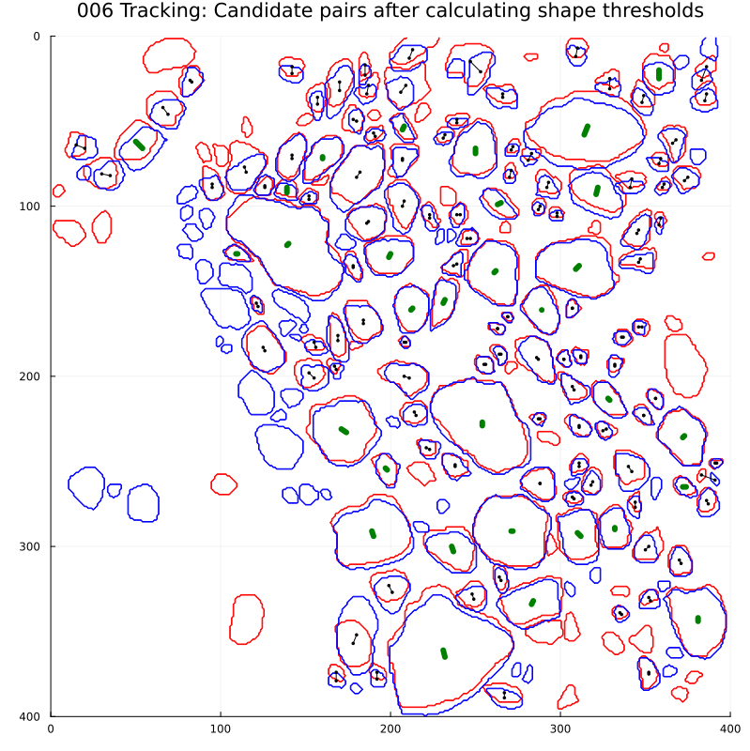
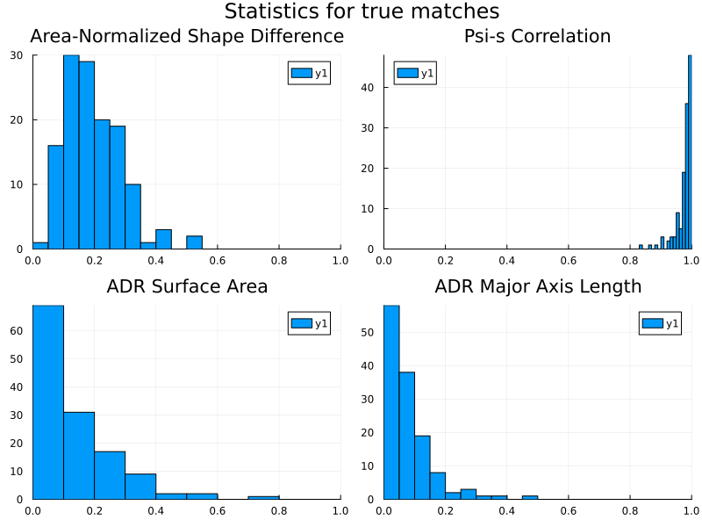
Case 6: Short enough time window and large enough floes to find correct matches by finding the nearest floe centroid that is within a 1 m/s travel range, and filtering out ~2 vectors that had higher than 3x the standard deviation of velocities (Black lines). These are mostly in the small floes category (<1200 pixels) and include some that are smaller than the 100 pixel minimum I’ve set here. Green lines show the matches that remain after the geometric parameters are applied.
Comparison of the default parameters (black lines) with the statistics for the true matches (just for this image). We can see that the thresholds are rejecting a lot of the true matches (in the case of the geometric measures) and would allow a lot of poor matches for the psi-s correlation.

Slide 36
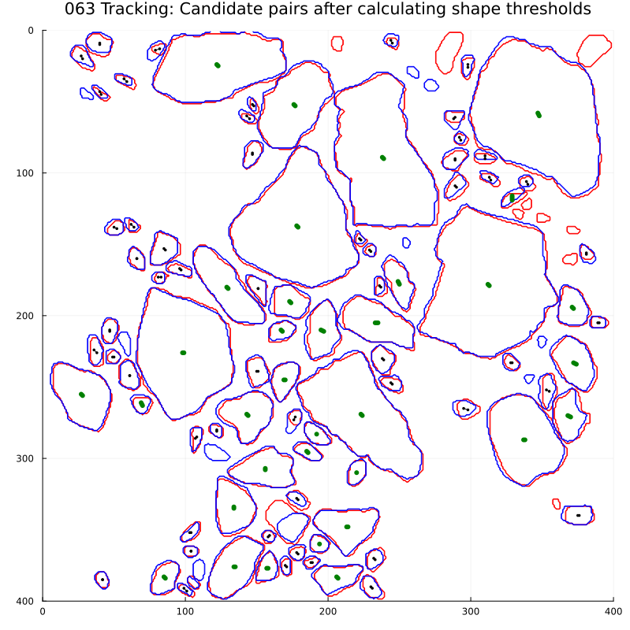

Case 63: As before.
Comparison of the default small floe parameters (black lines) with the statistics for the true matches. Orange lines are the large floe parameters. As before, lots of good matches are rejected.

Slide 37

Notes:
For small floes, the upper limit is quite high at 56%.
For the psi-s correlation, we note that the true rotation for the matched pairs is likely very small, since the images are close together. Thus discretization errors are more likely to appear in the simulated large rotations than in the true small rotations.

Slide 38

5. Tracking: Uncertainty
We can get information on the uncertainty of the match and the estimated angle through a few mechanisms. Each of the measures we use provides at least some information. I’ll focus on a few possibilities:
Correlation: Pearson correlation uncertainty depends on the sample size, which here depends on the perimeter. So we can directly get a confidence interval and select candidate floes that are within that range.
Shape difference: To estimate the rotation rate, we are computing shape difference at a range of angles. The shape difference range depends on the size and shape of the floe. I show a scaled SD curve at the bottom right. The narrowness and depth of the trough tell us something about the confidence of the angle.
The figures here show the results of the matched pairs and rotation tests. I find that rotation affects the psi-s correlation more than it does the shape difference. Normalization by the perimeter seems to scale the difference between rotated shapes very well, but across matched pairs there is some variation as floes get larger.
Some important considerations:
It is possible for a shape to be a correct match and have fairly low psi-s correlation. However, the psi-s correlation is usually above 90 percent for all but the smallest floes.
The spread in correlation between matched pairs and rotated pairs decreases with increasing floe size: large floes can be constrained more precisely by correlation.
The shape difference for matched pairs

Slide 39



5. Tracking: Estimating best thresholds for the absolute difference ratios
Definition of ADR For a measure m and a pair of floes f, g, we define a normalized distance $$ADR_{m}\left(f, g\right)=\frac{2|m\left(f\right)−m\left(g\right)|}{m\left(f\right)+m(g)}$$
Defaults (Lopez-Acosta et al. 2019, may be different in MATLAB)
Experiments
Variation under rotation Compute max(ADR(f, rotate(f)) across range -45 to 45 and range of floe sizes.
Variation between images (matched pairs) Floes paired between Aqua and Terra images from the same day based on overlap fraction; all pairs manually validated.
Variation between unmatched pairs Randomly pair floes from within the same log- spaced area bin
Floe Size | Area | Convex Area | Major Axis Length | Minor Axis Length
Area < 1200 px² | 0.18 | 0.09 | 0.07 | 0.08
Area > 1200 px² | 0.28 | 0.14 | 0.10 | 0.12
In images with low drift speeds, overlaying the manual labels from Aqua and Terra images shows clear overlaps that can be used to pair objects. Variation in shapes can inform us about the uncertainty in the floe shapes in a “best case” segmentation outcome, where the shape accuracy depends on lighting, atmospheric optical depth / cloud cover, and ice compactness.
Example of manually rotating floe
Notes:
Additional tests
The above experiments focus on shape variation with true ice floes. Another function of the ratios could be considered the question of screening false positives. However, that type of screening may be best at a different stage in the algorithm.
Notes
Open experiment design question: how many labeled images should be left out of the parameter fitting, threshold estimation, etc. tests for testing at the end?
Check default settings for box plot. What are the percentiles shown by the whiskers?

Slide 40



5. Tracking: Estimating best thresholds for the absolute difference ratios
Definition of ADR For a measure m and a pair of floes f, g, we define a normalized distance $$ADR_{m}\left(f, g\right)=\frac{2|m\left(f\right)−m\left(g\right)|}{m\left(f\right)+m(g)}$$
Defaults (Lopez-Acosta et al. 2019, may be different in MATLAB)
Experiments
Variation under rotation Compute max(ADR(f, rotate(f)) across range of angles and range of floe sizes. All n= 1,976 floes larger than 50 px, from 74 labeled images (Aqua only to avoid duplicates). Angles: -45 to 45, step size 3. Log-spaced bins. Only bins with at least 20 floes shown. Bins up to area 649 all have n > 100. Finding: Strong dependence on area, uncertainty decreases with increasing floe size. Convex area uncertainty clearly highest.
Variation between images (matched pairs) Floes paired between Aqua and Terra images from the same day based on overlap fraction; all pairs manually validated. Total floe pairs n=1,113. Bins up to area 456 have n > 100; final two bins have n < 20. Much larger uncertainty than from rotation. Less difference between measures. Potential drop-off in uncertainty for large floes (area > 1000 px²); tentative due to small sample size. Also note potential distinction between ~200 and 300 px².
Variation between unmatched pairs (next slide)
Floe Size | Area | Convex Area | Major Axis Length | Minor Axis Length
Area < 1200 px² | 0.18 | 0.09 | 0.07 | 0.08
Area > 1200 px² | 0.28 | 0.14 | 0.10 | 0.12
Bin boundaries are logarithmically spaced in area and are the same in each plot. Tick marks are labeled with the bin-mean area; hence small differences between top and bottom panels. Box-and-whiskers show the median (center line), 25-75 range (IQR, box width), and whiskers extend from the box to the most extreme data point within 1.5*IQR past the median.
Notes:
Additional tests
The above experiments focus on shape variation with true ice floes. Another function of the ratios could be considered the question of screening false positives. However, that type of screening may be best at a different stage in the algorithm.
Notes
Open experiment design question: how many labeled images should be left out of the parameter fitting, threshold estimation, etc. tests for testing at the end?
Check default settings for box plot. What are the percentiles shown by the whiskers?

Slide 41



5. Tracking: Estimating best thresholds (cont’d)
Definition of ADR For a measure m and a pair of floes f, g, we define a normalized distance $$ADR_{m}\left(f, g\right)=\frac{2|m\left(f\right)−m\left(g\right)|}{m\left(f\right)+m(g)}$$
Defaults (Lopez-Acosta et al. 2019, may be different in MATLAB)
Experiments
Variation under rotation Strong dependence on area, uncertainty decreases with increasing floe size. Convex area uncertainty clearly highest.
Variation between images (matched pairs) Much larger uncertainty than from rotation. Less difference between measures. Possible size effects ~ 300 px², ~1200 px²
Variation between unmatched pairs Divided Aqua floe shapes into area bins, listed all possible combinations of floes, then selected 500 from each bin at random. The randomized pairings do not show any clear area dependence. Surprisingly, the variation between matched pairs is larger than the random pairs for the small floe cases. We note also that the axis length ADRs tend to be smaller than the random pairs, and appear distinctly smaller for floes larger than 200-300 pixels. Area measures maintain substantial overlap even with very large floes.
Floe Size | Area | Convex Area | Major Axis Length | Minor Axis Length
Area < 1200 px² | 0.18 | 0.09 | 0.07 | 0.08
Area > 1200 px² | 0.28 | 0.14 | 0.10 | 0.12
Notes:
Additional tests
The above experiments focus on shape variation with true ice floes. Another function of the ratios could be considered the question of screening false positives. However, that type of screening may be best at a different stage in the algorithm.
Notes
Open experiment design question: how many labeled images should be left out of the parameter fitting, threshold estimation, etc. tests for testing at the end?
Also, it’s not clear in the paper what the percentages are calculated relative to.

Slide 42

5. Tracking: Next steps
Next steps:
Using comparison between matched and random pairs to find best parameters for ADR thresholds. These tests don’t need to be as stringent as the psi-s and shape difference tests
Question of whether area + convex area + maj/min axes is the most useful set of measures for the algorithm. Alternatives:
Solidity = area/convex area
Eccentricity
Carry out psi-s correlation and shape difference estimation
Potential to use length of floe boundary in test of statistical confidence in correlation, esp. for question of tie breaking
The rotation rates for the previous experiment were used to check the accuracy of the floe registration function
Issues with angle domain, cutoffs.
Working with CCV on issues with the floe registration function. The function we’re using is intended for grayscale images, some strange results with binary floe masks
Testing using simpler registration function based on the method Rosalinda wrote about in the paper, rather than the function she used in the MATLAB code (Example notebook)
Defaults in 2019 paper
Floe Size | SD | Psi-S
Area < 1200 px² | 0.18 | 0.7
Area > 1200 px² | 0.24 | 0.7
Notes:
Note: Units for the SD are not exactly clear in the paper.

Slide 43
5. Tracking: Next steps
Algorithm updates and questions
Uncertainty calculations for tracking
Psi-s correlation confidence interval -> can use this to determine likely matches with some probabilistic information (4 hrs)
Rotation/SD confidence -> the depth and width of the trough and the confidence in the shape difference, can get the distribution of best-fits from the true matches in the validation dataset (20 hrs)
Questions for how to use uncertainty info for the matching in the end
Pre-filtering
Joint distributions rather than thresholds for comparing shape geometries (more discriminatory power, addressing correlation)
Potential to use cross correlation, image shifts for matching non-unique floes
Notes:
Note: Units for the SD are not exactly clear in the paper.

Slide 44
Studies/papers that may be useful
On the use of daily optical imagery for sea ice velocity analysis
Timescales of ice motion (hourly, daily, weekly) vs uncertainty. Analysis using meander coefficients from Alan’s work.
Available timescales for linked trajectories based on cloud cover. Potentially using Sami’s work, alternatively, just use the cloud fraction dataset (e.g. could be place to do the eval of the cloud fraction dataset).
Relationship between cloud cover, wind speed, and the observed portion of the velocity distribution.
This paper would help benchmark performance needs. I.e., are we getting as long of trajectories as we can given the cloud cover properties? How should we interpret our velocity distributions vs. the true distributions?
Relative and absolute dispersion of tracked ice floes
Uncertainty analysis for limits of the interpolation step, questions of how to handle the floe position uncertainty in the dispersion calculation
Confidence intervals for the slope of the dispersion
Link between dispersion and deformation strain rates
Compare/contrast sea ice regions, with analysis of Greenland Sea vs Beaufort Sea
“We are preparing two manuscripts focused on the Lagrangian statistics of the sea ice trajectories: the first, “Sea ice dispersion mirrors underlying submesoscale ocean currents amid strong atmospheric forcing”, by Watkins, Lopez-Acosta, Kim, and Wilhelmus, focuses on the absolute dispersion of Fram Strait IFT trajectories and trajectory-based eddy detection and will be submitted to Nature Geoscience.
The second focuses on multi-particle statistics, including relative dispersion and structure function analysis, and includes intercomparison with multiple drifting buoy deployments. This paper has the working title “Lagrangian statistics of in-situ and remote sensing sea ice observations in the Spring- and Summertime Marginal Ice Zones” and will be submitted to The Cryosphere. “
Seasonality of the FSD in Arctic MIZs
Extend analysis from the Annals paper into the whole set of MIZs
Compute sea ice fraction, total ice area for each scene for looking at interannual variability. What fraction of the ice cover consists of identifiable ice floes?
Preconditioning: test hypothesis that the FSD in April or March is a predictor of the FSD slope in the late season

Slide 45
Paper: Evaluation of sea ice segmentation with manually labeled imagery
Using a set of manually identified sea ice floes, we carry out an experiment to test the sensitivity of a set of segmentation quality metrics to errors in object properties and sampling. As an example, we apply the best-performing metrics to a set of segmentation results from two versions of an ice floe segmentation and tracking algorithm.

Slide 46
1. Objectives and overview
Adapt practices from GEOBIA and computer vision to the challenge of evaluating sea ice segmentation quality
Determine measures to use for calibration
Introduce the random sample dataset
Test the measures with two versions of IFT

Slide 47
1. Data: Random sample dataset
Random sampling procedure. Aim is to select random (x, y, t) triads (position and time) from the marginal ice zone (MIZ).
MIZ defined by SIC between 15 and 85%
Further requirement that the 100 km by 100 km square centered at (x, y) have SIF (area of pixels with > 15% SIC) larger than 0.25.

Slide 48
1. Data: Synthetic dataset
Adding known errors so that we can test the sensitivity of metrics.
Sampling bias: increasing fraction of false negatives. Randomly select floes to delete. Also test sensitivity to deleting small floes vs large floes.
Sampling bias: increasing fraction of false positives. Randomly add circles of similar sizes to blank areas of images. Test sensitivity with small vs large floes.
Area bias: dilate floes by n pixels (n from 1 to 10 or so), erode floes by n pixels.
Boundary errors: will need a way to do this. Perhaps replacing floes with shape with similar size, but not overlapping with other floes? Area change also affects the boundary.
Oversegmentation and undersegmentation. For undersegmentation, I can join objects, either through dilation or through

Slide 49

Bering-Chukchi Seas – some edge cases, could move box slightly to the right and down, so that the right boundary goes through Wrangel Island and the lower boundary through Point Barrow.
Beaufort Sea – shrink the box so that the eastern border is at the island, northern border doesn’t really matter much.
Canadian Archipelago - new tile, include the Beaufort Sea images that were already analyzed.
Hudson Bay – extend slightly to the south and east
Baffin Bay – narrower, extend further south.
Greenland Sea – Svalbard to the North, iceland to the south, Jan Mayen to the east,
Barents-Kara Seas – share border with Laptev and Greenland sae
Laptev Sea – make smaller, reassign samples to the East Siberian sea. Make “north” edge the same.
East Siberian Sea – wrangel island to the west, new siberian islands to the right
Sea of Okhostk – very few images with visible floes. Should sampling continue until n images with visible floes are identified? Does it matter?

Slide 50



Slide 51
Numerical Experiments
Aim: test the effectiveness of metrics at detecting specific types of error
Representation errors from biased sampling
Remove X% of objects
Remove X% of the large objects (75th quantile and above)
Remove X% of the small objects (25th quantile and below)
Location errors
Simple test with translation by n pixels
Errors in shapes will also affect location. Centroid may move with erosion/dilation, and from merging with nearby objects.

Slide 52
Algorithm flowchart
Preprocessing
Nonlinear diffusion
Brighten floes
Grayscale reconstruction
Adjust histogram
Unsharp mask
Compute residue
Cloud mask and land mask
Notes:
Some big questions
Is the result any different if we do nonlinear diffusion on the grayscale image instead of the truecolor image? If not, that’s a 3x speedup for the diffusion step.
Likewise, is it important that we do the adaptive histogram in color space before casting to grayscale?

